Slide 1

Report for RA

Slide 2

Agenda
Project list
What we have done this week
What we are going to do next week

Slide 3

Project list & status
CEO report
I : discussing
II : data preparing & checking
III: DM building & checking
IV: Report building
Data checking
History data checking – delay (system issues)
Others
Temporary report
Bug fixing
Notes:
核对2013与2012年的历史数据。不考虑2011年的数据。

Slide 4
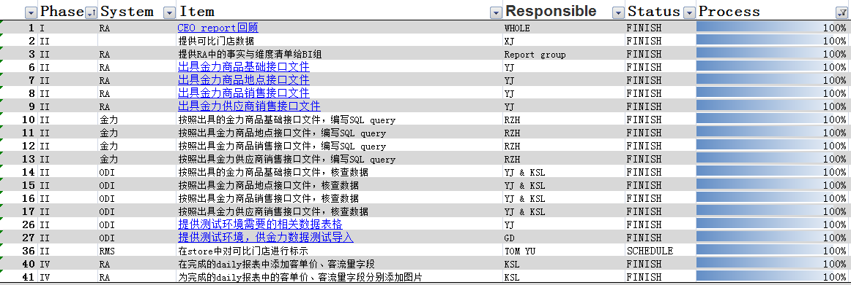

What we have done this week
CEO report
Others
Temporary reports for Marketing
Bug fixing

Slide 5
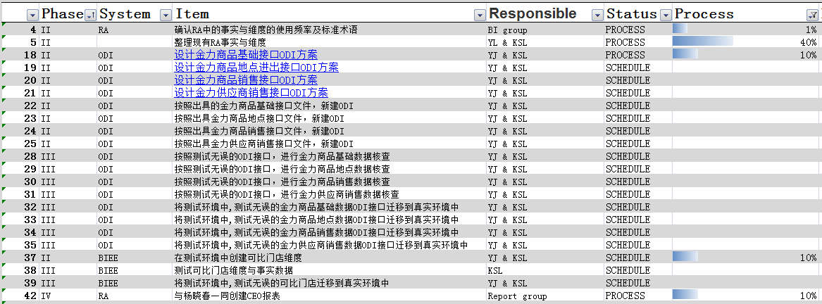

What we are going to do next week
CEO report
Data checking
Depends on the system

Slide 6

Thank you

